Slide 1
Week 1
Excel Basics: continued

Slide 2
Reminder
Upload in-class work for the week to the Dropbox by Monday a the end of class every week
Take the daily quiz during class

Slide 3
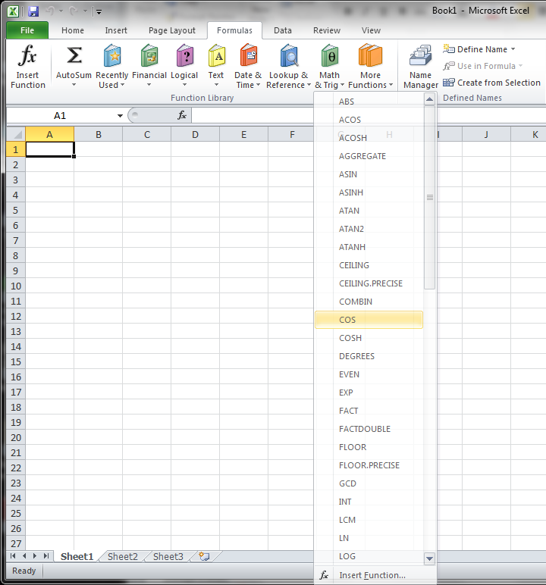
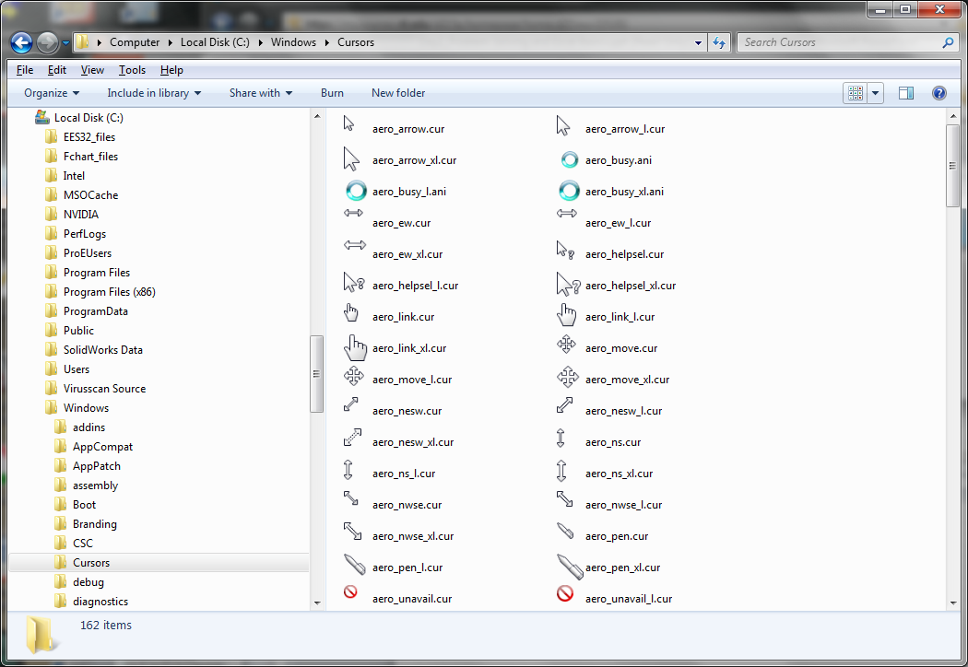
Built In Functions
Formulas → Insert Function → Pull from list…
Trig Functions
=sin(angle radians)
=cos(angle in radians)
Other Common Functions
=pi() ←no argument!
=radians(angle in deg.)
=sum(num1,num2,… )
=sqrt(number)
=exp(number)

Slide 4
Built In Function Usage
All Excel functions have a name and require one or more arguments (inputs)
Example: =SUM(A1,A2,A3) Function Name: “Sum” (output is sum of all arguments) Arguments: cell references containing values to be summed
Can use a range of cells for an argument if function supports it Instead of clicking on individual cells, click and drag a range Example: =SUM(A1:A3) Gives same output as first example
=PI() is an exception, it takes no argument and returns value of π to 14 decimal places

Slide 5
Day 3 and Day 4 Inclass_Exercises
There are 4 problems in this ppt file. (Problem 5 is optional)
In the same single workbook, solve problem #1 in “Sheet1”, problem #2 in “Sheet2”, etc…
Upload the final workbook on Day 4 with all the four problems solved into the Dropbox. (The Dropbox closes at 11:30 pm on Friday if you do not finish during class on Day 4.)

Slide 6
Problem #2:
A cylindrical tank of radius r (m) and height h (m) is filled with water at a rate of F (m³/min). How much time does it take to fill the tank (t, in seconds)?
Use r = 0.75 m; h = 1.25 m; and vary F from 0.5 to 5 m³/min with step sizes of 0.25 m³/min
F
r
h
Notes:
Number formatting, formulas, functions, referencing

Slide 7


Problem #3:
A baseball has an initial speed V0 = 12 m/s and is thrown with an initial angle of 25 degrees from the horizontal. Use a time increment δt=0.01 s, starting from zero and stopping when the ball hits the ground.
The horizontal position x(t) and vertical position y(t) are given by
At what horizontal position does the ball hit the ground? (g=9.81 m/s²)
$$x\left(t\right)=V_{o} t \cos{θ}$$
$$y\left(t\right)=V_{o} t \sin{θ}−\frac{1}{2} g t^{2}$$

Slide 8

Problem #4:
Set up an Excel worksheet to evaluate the function g(x ,y)
Construct a table that shows the values of g(x,y) for all values of x between 0 and 10 in increments of 1, and for all values of y between 100 and 240 in increments of 20.
Make your table so that you can click on the formula in one cell and copy it to all other cells.
$$g\left(x,y\right)=x∙y$$

Slide 9

Problem #5:
Set up an Excel worksheet to evaluate the function f(x,y) (function of two variables )
Construct a table that shows the values of f(x,y) for all values of x (radians) between 0.5 and 2.0 in increments of 0.1, and for all values of y (radians) between 0 and 2.0 in increments of 0.1.
Assume that the value of A is 2.5, but make allowances in your setup such that A could easily be changed without having to reconstruct the entire table manually.
$$f\left(x,y\right)=A \cos^{2}{x} \sin^{2}{y}$$

Slide 10

Problem #6: (optional)
If you have additional time, you can do this
The density of standard air is a function of temperature and may be approximated using the ideal gas law, according to
Where ρ = density (kg/m³), P = standard atmospheric pressure (101.3 kPa), R = gas constant; its value for air is 286.9 (J/kg-K), T = air temperature in Kelvin
Create a table that shows the density of air as a function of temperature in the range of 0˚C (273.15 K) to 50˚C (323.15 K) in increments of 5˚C.
$$ρ= \frac{P}{RT}$$

